Slide 1
Uncertain Knowledge and Reasoning
By Dr. Sonali Patil

Slide 2
Reasoning Under Uncertainty
Uncertainty
Sources of uncertainty
Methods to handle Uncertainty
Probability Theory
Uncertainty and Rational Decisions
Basic Probability Notations
Probability Axioms
Independence
Bayes Rule
Bayesian Networks

Slide 3

Uncertainty
Reasoning under uncertainty.
There are different types of uncertainties. What are the different ways in which you can deal with that?
The doorbell problem
The doorbell rang at 12 O'clock at midnight.
Que to ans
was someone there at the door?
Mohan was sleeping in the room. Did Mohan wake up when the doorbell rang?
My fact is that the doorbell rang at 12 O'clock in the midnight. Therefore if we place the propositions in the logic form

Slide 4
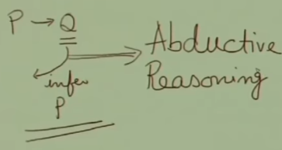
Uncertainty
Given Doorbell, can we say AtDoor(x), because
AtDoor(x) Doorbell?
Can we say that there is some one at Door? We can using the deductive reasoning/normal implication (p implies q, if p true…Q is necessarily true, if p false…q may be or may not be true)
Abductive Reasoning (p implies q and we find q is true then we infer p. Most of the time right, but may not always). Other reasons, though rare
Short Circuit
Wind
Dog or other Animal pressed the button
Notes:
Can we say that there is someone at the door? In classical proposition logic, p implies q means if p is true then q is necessarily true but if p is false then q maybe true or q maybe false. So, according to deductive reasoning if we know doorbell has rung then we cannot say for sure that there was someone at the door using normal implication because p implies q means if p is true then q is true. But q can be true even if p is false so if
q is true then p may or may not be true.
According to deductive reasoning if there is doorbell ringing then we cannot say for sure at door x. But using our common sense or day-to-day style of reasoning often we tend to conclude if there is a doorbell then someone is at the door. Although according to deductive reasoning that may not be true. So this sort of reasoning where if there is something like p implies q and we find q is true then we infer p. This may not be correct according to deduction but that is what we often do and this sort of reasoning is known as abductive reasoning.

Slide 5
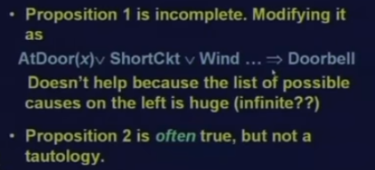
Uncertainty
Given Doorbell, can we say Wake(Mohan), because
Doorbell Wake(Mohan)?
Using, Deductive Reasoning. Yes, if proposition 2 is always true
However always this may not be true (May be tired and in sound sleep)
Hence, we cannot answer either of Questions with certainty.
Notes:
Tautology… something which always true A OR NOT_A always true

Slide 6
Uncertainty
Planning Example
Let action A(t) denote leaving for the airport t minutes before the flight
– For a given value of t, will A(t) get me there on time?
Problems:
– Partial observability (roads, other drivers’ plans, etc.)
– Noisy sensors (traffic reports)
– Uncertainty in action outcomes (flat tire, etc.)
– Immense complexity of modelling and predicting traffic

Slide 7
Uncertainty
Diagnosis always involves uncertainty.
Eg:
Dental diagnosis: (toothache)
Toothache Cavity
Its wrong as not all people with toothaches have cavity. It may be due other problems
Toothache Cavity V Gum Problem V Abscess…….
In order to complete the list, we have to add an almost unlimited list of possible problems
The causal rule for this:
Cavity Toothache
This is not also the right one. Not all cavities cause pain

Slide 8
Uncertainty
Trying to cope up with domains like Medical diagnosis fails for 3 main reasons:
Laziness:
Too hard to list out all antecedence & consequents needed to ensure an exception-less rule and too hard to use such rules.
Theoretical ignorance:
The domains like Medical science has No complete theory for the domain.
Practical ignorance:
Even all rules are known – uncertain about a particular patient. Not all test have been or can be run.

Slide 9
Uncertainty
The problems like Doorbell/diagnosis are very common in real world
In AI, we need to reason under such circumstances
We solve such problems by proper modelling of Uncertainty and impreciseness and developing appropriate reasoning techniques
Notes:
Uncertainty in a fact/rule --- it rained, it will rain tomorrow, it will rain today, it rains in July etc are statements which are uncertain because although mostly it rains in July in the eastern parts of India but in many of the parts it is not always certain that everyday in July it will rain. So these sort of statements are always associated with some sort of uncertainty.
On the other hand, impreciseness is inherent in most of the statements we make.
The boy is very tall, water is quite hot, it is quite likely that it will rain in July. What do you mean by likely/very/quite? The boy is very tall, what do you mean by very? I like him very much, how much do you like him? Is it 5, 10, 15? Now these are not precise statements. The
height of the building is for example 20 ft, 200 ft or whatever then we quantify that and that is precise. But mostly many of our statements are not precise. Therefore in order to deal with real life problems we have to handle both uncertainty and impreciseness and that can be handled using appropriate reasoning techniques.

Slide 10
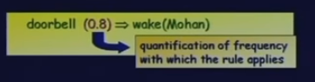
Sources of uncertainty
Implications may be weak
Imprecise language like often, rarely, sometimes
Need to quantify these terms of frequencies
Need to design rules for reasoning with these frequencies
Precise information (input) may be too complex
Too many antecedents or consequents
Incomplete Knowledge
We may not know or guess all the possible antecedents or consequents
The bell rang due to some spooky reason
Notes:
That means my knowledge is incomplete. So, in order to build a system
robust and reasonably good and at least trying to mimic human intelligence we have to deal with such incomplete knowledge.

Slide 11


Sources of uncertainty
Conflicting Information
Patient-complicated symptoms-two diff doctors-may be possible they differ in there diagnosis if the symptoms do not lead to a vary obvious disease
Propagation of Uncertainties
In absence of interdependencies of propagation of uncertain knowledge the uncertainty of the conclusions increases
Notes:
And there is another problem here that uncertainties are often propagated. I
had a scenario that a implies b and b implies c, if I perform chaining and suppose a is
true then I come here and take this tool and infer b and since b is true I come to this
rule and infer c. This is chaining and in each of these implications that I had here
it was a certain implication so it was with a belief one and this was also with a belief
one. But now if I say that a implies b with some
certainty .7 and b implies c with some belief .6 and I know a then obviously the strength
of belief with which I know b is less than it was here. So I infer b with a less belief
and then I come to this rule and propagate so this thing is propagated, this lack of
belief is propagated here and again this rule is not certain because it has got a
strength .6 so I infer c with even weaker belief. Now let us take another scenario that
a implies b.
The strength of belief is .7 and a is known with some uncertainty, a is not known for
sure and suppose a is known with some certainty of .8 now here this implication is a weak
implication and further this antecedent is also not surely known so the strength with
which b is inferred is also weaker than either .7 or .8. So if I had b implies c then with
some belief of .8 this implication then through this chain of reasoning c will be inferred
with a much weaker belief. This is what we mean by propagation of uncertainty.
So, in the absence of interdependencies of propagation of uncertain knowledge the uncertainty of the conclusion increases. Here is an example.
Suppose I know tomorrow will be sunny with a belief .6 and tomorrow will be warm with
a belief .8. When I take them together; Tomorrow will be sunny and tomorrow will be warm what will be the certainty of this conjunction? This is a conjunction of these two uncertain
statements uncertain propositions tomorrow is sunny tomorrow is warm. When I take them together what will be the strength of belief in this conjunction?

Slide 12
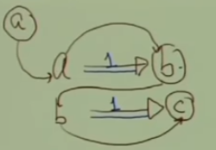
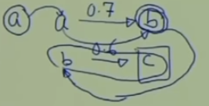
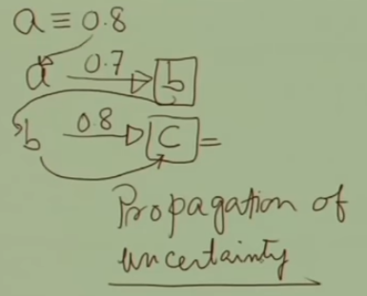

Slide 13
Methods of handling Uncertainty
Fuzzy Logic
Logic that extends traditional 2-valued logic to be a continuous logic (values from 0 to 1)
while this early on was developed to handle natural language ambiguities such as “you are very tall” it instead is more successfully applied to device controllers
Probabilistic Reasoning
Using probabilities as part of the data and using Bayes theorem or variants to reason over what is most likely
Hidden Markov Models
A variant of probabilistic reasoning where internal states are not observable (so they are called hidden)
Certainty Factors and Qualitative Fuzzy Logics
More ad hoc approaches (non formal) that might be more flexible or at least more human-like (MYCIN expert system)
Neural Networks
Notes:
MYCIN was an early backward chaining expert system that used artificial intelligence to identify bacteria causing severe infections, such as bacteremia and meningitis, and to recommend antibiotics, with the dosage adjusted for patient's body weight — the name derived from the antibiotics themselves, as many antibiotics have the suffix "-mycin".
Suggestive evidence…if symptoms are so and so then there is suggestive evidence 0.7 that the disease is so and so
This value 0.7 points to some uncertainity or some Weakness in the strength of the belief in the conclusion. Ex. If two sides of triangle are equal, triangle is isosceles triangle. No uncertainity
In real life scenarios like medical reasoning, automobile diagnosis…we cannot be very sure about either evidences, or if the evidences are known and its relationship with the conclusion. There is uncertainity

Slide 14
Uncertainty tradeoffs
Bayesian networks: Nice theoretical properties combined with efficient reasoning make BNs very popular; limited expressiveness, knowledge, engineering challenges may limit uses
Non-monotonic logic: Represent commonsense reasoning, but can be computationally very expensive
Certainty factors: Not semantically well founded
Fuzzy reasoning: Semantics are unclear (fuzzy!), but has proved very useful for commercial applications

Slide 15
Probability Theory
Deals with degrees of belief
Provides a way of summarizing the uncertainty that comes from our laziness & ignorance thereby solving the qualification problem (specifying all exceptions)
A90 will take us to airport on time, as long as car doesn't break down or run out of gas, does not indulge into accident, no accidents on bridge, plane doesn't live early, no meteorite hits the car, and ….)
0.8
Toothache cavity
The probability that the patient has a cavity, given that she has a toothache is 0.8

Slide 16
Probability Theory
Consider previous statement: “The probability that the patient has a cavity, given that she has a toothache is 0.8”
If we later learn that patient has a history of gum disease we can say “The probability that the patient has a cavity, given that she has a toothache and a history of gum disease, is 0.4”
If further we gather evidence, we can say “The probability that the patient has a cavity, given all we know now, is almost zero”
Above three statements do not contradict each other; each is a separate assertion about a difference knowledge state

Slide 17
Uncertainty and rational decisions
“Say A90 has 92% chance of catching our flight. Is it rational choice? Not necessarily
A180 has higher probability of reaching. If its vital to not miss the flight, then its worth risking the longer wait time at airport
A1440 almost guarantees reaching on time but I’d have to stay overnight in the airport (intolerable wait and may be unpleasant diet of airport food)
To make choices, an agent must have preferences between different possible outcomes of various plans
Utility Theory is used to represent & reason with preferences

Slide 18
Uncertainty and rational decisions
Utility Theory
Every state has a degree of usefulness or utility, to an agent and the agent will prefer states with higher utility.
The utility state is relative to agent
Ex. Consider the state in which White has checkmated Black in chess. Here, Utility is high for agent playing White but low for agent playing Black
A Utility function can account for any set of preferences- quirky or typical, noble or perverse

Slide 19
Uncertainty and rational decisions
Decision Theory
Preferences as expressed by utilities, are combined with probabilities in general theory of rational decisions
Decision Theory = Probability Theory + Utility Theory
Maximum Expected Utility(MEU)
An agent is rational if and only if it chooses the action that yields the highest expected utility, averaged over all possible outcomes of the action. This is principle of MEU
Here the term expected is not vague. Its average or statistical mean of outcomes weighted by the probability of outcome.
The basic difference between A decision-theoretic agent & other agents is that the former’s belief state represents not just the possibilities for world states but also their probabilities

Slide 20
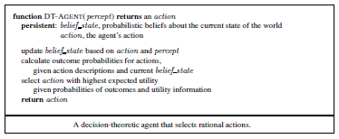
Uncertainty and rational decisions

Slide 21
Uncertainty and rational decisions summary
Rational behavior:
For each possible action, identify the possible outcomes
Compute the probability of each outcome
Compute the utility of each outcome
Compute the probability-weighted (expected) utility over possible outcomes for each action
Select the action with the highest expected utility (principle of Maximum Expected Utility)

Slide 22
Bayesian reasoning
Probability theory
Bayesian inference
Use probability theory and information about independence
Reason diagnostically (from evidence (effects) to conclusions (causes)) or causally (from causes to effects)
Bayesian networks
Compact representation of probability distribution over a set of propositional random variables
Take advantage of independence relationships

Slide 23
Basic Probability Notation
A random variable is a variable whose possible values are the numerical outcomes of a random experiment.
It is a function which associates a unique numerical value with every outcome of an experiment.
Its value varies with every trial of the experiment.
It describes an outcome that cannot be determined in advance
It is Boolean , Discrete or continuous
Ex. Roll of a die, number of emails received in a day etc.
The sample space S of the random variable X is the set of all possible worlds
The possible worlds are mutually exclusive & exhaustive (at a time one possible outcome and all possible outcomes are in the S)
Tossing a coin: S={H,T}
Tossing two coins simultaneously S={HH, HT, TH, TT}
Rolling a die: S={ 1,2,3,4,5,6}

Slide 24
Basic Probability Notation
An atomic event is a complete specification of the state of the world about which the agent is uncertain.
Eg:
Cavity & Toothache has four distinct atomic events.
Cavity = False ∧ Toothache = True
Cavity = True ∧ Toothache = True
Cavity = False ∧ Toothache = False
Cavity = True ∧ Toothache = False

Slide 25
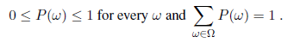
Basic Probability Notation
The sample space is denoted by Ω (upper case omega) and elements in sample space are denoted by ω (lower case omega)
P(ω ) -> Probability of occurance of ω
Probabilistic assertions & queries are not about particular possible worlds, but about sets of them
The two dice add upto 11, Doubles are rolled; Picking ace from pack of cards, number of email> 100 in a day, etc.
These sets are called events. Event is subset of ω
Events are described by proposition in common language

Slide 26
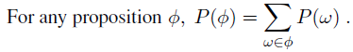
Basic Probability Notation
The probability associated with the proposition is defined to be the sum of the probabilities of the world in which the proposition holds
ϕ is getting odd number after rolling the dice
S={1, 2, 3, 4, 5, 6}, ϕ ={1, 3, 5}
P(Odd)=P(1)+ P(3) + P(5)= 1/6 + 1/6 + 1/6 = ½

Slide 27
Unconditional or Prior Probabilities
Degree of belief in proposition in the absence of any other information/evidence
P(Fever)=0.1
The probability that the patient has fever is 0.1(in absence of any other information
A die is rolled, P(odd), P(even) indicated the probability of getting the even number and the probability of getting the even number on the rolled dice respectively. Both of these are prior probabilities
When a pair of dice rolled simultaneously, the possible outcomes are 36. P(doubles), P(Total=15) are prior probabilities

Slide 28
Unconditional or Prior Probabilities
The random variables Fever, Doubles, Odd, Even are Discrete Random variables as they take finite number of distinct values
The Boolean random variables have values True or false ex. P(cavity)
A continuous random variable is a random variable that takes infinite number of distinct values
EX. P(Temp=x) = Uniform_{[18C,26C]} (x)
Expresses that the temperature is distributed uniformly between 10 and 26 degrees
This is called Probability Density Function

Slide 29
Conditional or Posterior Probabilities
Let A be an event in the world and B be another event. Suppose that events A and B are not mutually exclusive, but occur conditionally on the occurrence of the other. The probability that event A will occur if event B occurs is called the conditional probability. Conditional probability is denoted mathematically as p(A|B) in which the vertical bar represents GIVEN and the complete probability expression is interpreted as “Conditional probability of event A occurring given that event B has occurred”.

Slide 30
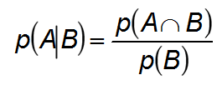
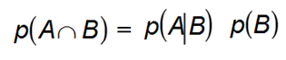
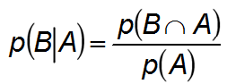
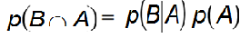
Conditional or Posterior Probabilities
The number of times A and B can occur, or the probability that both A and B will occur, is called the joint probability of A and B. It is represented mathematically as p(AՈB). The number of ways B can occur is the probability of B, p(B), and thus
The eq. of conditional can also be written in the form
Similarly, the conditional probability of event B occurring given that event A has occurred equals
Product Rule
Product Rule

Slide 31
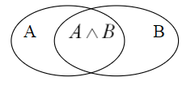
Probability Axioms
All probabilities are between 0 & 1
0 ≤ P(A) ≤ 1
Necessarily True propositions have probability 1 and necessarily false propositions have probability 0
( P(true) = 1 and P(false) = 0)
Probability of disjunction
P(A ∨ B) = P(A) + P(B) - P(A ∧ B)
These axioms often called as Kolmogorov’s axiom
Inclusion-Exclusion Principle

Slide 32
Probability Axioms
From Axioms we can derive other properties
P(A ∨ B) = P(A) + P(B) - P(A ∧ B) Substitute B = ¬ A
P(A ∨ ¬ A) = P(A) + P(¬ A) - P(A ∧ ¬ A)
1 = P(A) + P(¬ A) – 0
P(¬ A)= 1- P(A)
P(A) = 1- P(¬ A)
A and B mutually exclusive ➔ P(A ∨ B) = P(A) + P(B)
P(e₁ ∨ e₂ ∨ e₃ ∨ … e_{n}) = P(e₁) + P(e₂) + P(e₃) + … + P(e_{n})
The probability of a proposition a is equal to the sum of the probabilities of the atomic events in which a holds
e(a) – the set of atomic events in which a holds
P(a) = Σ P(e_{i})
e_{i}∈e(a)

Slide 33
Inference using Full Joint Distribution
Probability distribution P(Cavity, Toothache)
Toothache ∼ Toothache
Cavity 0.04 0.06
∼ Cavity 0.01 0.89
Sum of all entries =1
P(Cavity) = 0.04 + 0.06 = 0.1 (using Axioms)
P(Cavity ∨ Toothache) = 0.04 + 0.01 + 0.06 = 0.11
P(Cavity|Toothache) = P(Cavity∧Toothache)/P(Toothache)
= 0.04 / (0.04 + 0.01)
= 0.8
Obtain P(∼ cavity), P(Toothache), P(∼ Toothache), P(cavity| ∼ toothache) P(∼ cavity| toothache), P(∼ cavity| ∼ toothache),

Slide 34
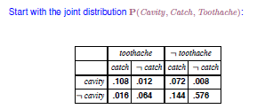
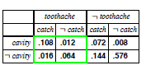
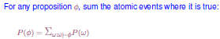

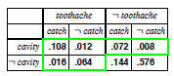
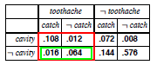
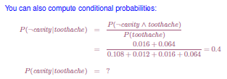
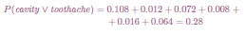
Inference using Full Joint Distribution
Notes:
Catch: the nasty dental probe catches in the cavity of tooth

Slide 35
Inference using Full Joint Distribution
P(cavity|toothache)= P(cavity^ Toothache)/ P(Toothache)
= (0.108+0.012)/(0.108+0.012+0.016+0.064) = 0.6
Observe, P(cavity|toothache)+P(∼ cavity|toothache) =0.6 + 0.4=1 as it should be
1/P(toothache) remains constant no matter which value of cavity we calculate. Such constants in probability are called as normalization constant

Slide 36
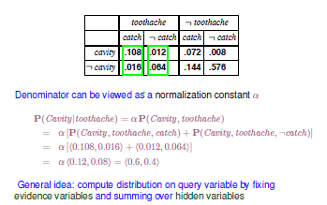
Inference using Full Joint Distribution

Slide 37
Independence
Independence is simplifying the modelling assumption
Variable represented for probability are
P( Weather, toothache , catch , cavity)
It can be deduced as
P(weather= cloudy) P(toothache ,catch ,cavity )

Slide 38
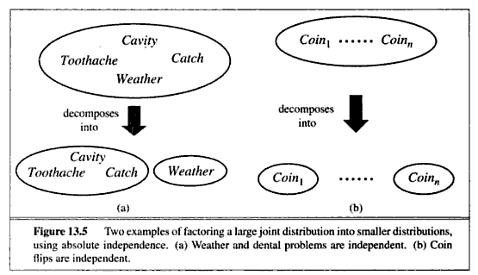
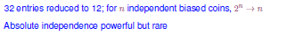

Slide 39
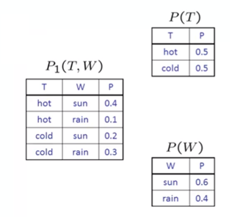
How to verify Independence?
Given a joint distribution P₁(T,W) how to verify T and W are independent or not
Build marginals for each of the variables. Her two variables so two marginals

Slide 40
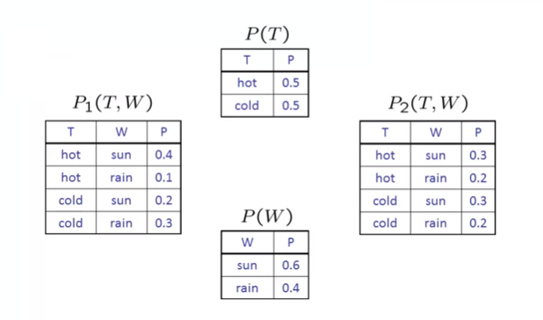
How to verify Independence?
Calculate another distribution P2(T,W) as P(T)*P(W)
If P1(T,W)= P2(T,W)… T and W are independent

Slide 41
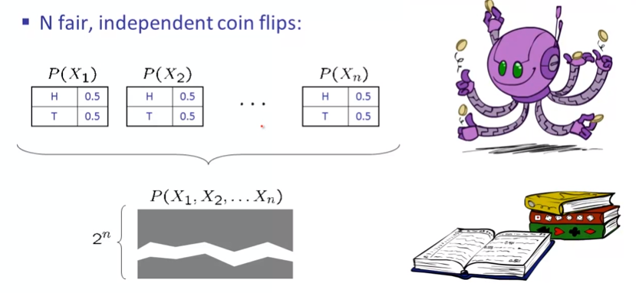
Example independence

Slide 42
Bayesian or Bayes Rule
Let A be an event in the world and B be another event.
Hence from product rule
P(A ∧ B) = P(A|B) *P(B)
P(A ∧ B) = P(B|A) *P(A)
LHS are same. Equating the RHS of both equations yields
P(A|B) = P(B | A) * P(A) / P(B)
P(B|A) = P(A | B) * P(B) / P(A)
where:
p(A|B) is the conditional probability that event A occurs given that event B has occurred;
p(B|A) is the conditional probability of event B occurring given that event A has occurred;
p(A) is the probability of event A occurring;
p(B) is the probability of event B occurring.
Bayes rule/ Bayesian rule

Slide 43
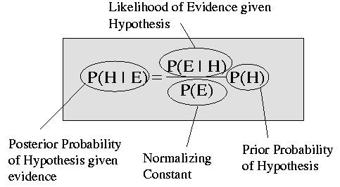
Bayesian or Bayes Rule (Hypothesis-Evidence)

Slide 44
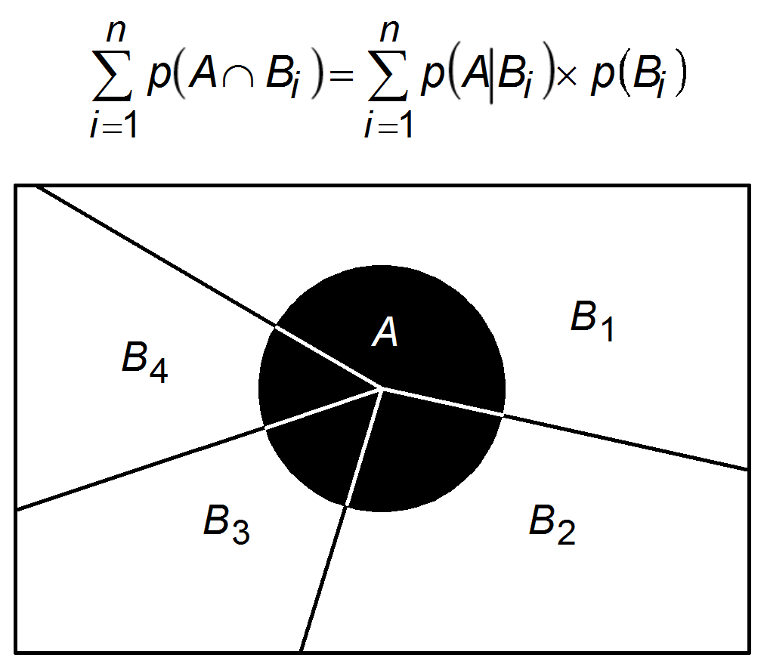
Bayesian or Bayes Rule
The Joint Probability

Slide 45
Bayesian or Bayes Rule
If the occurrence of event A depends on only two mutually exclusive events, B and NOT B , we obtain:
where ¬ is the logical function NOT.
Similarly,
Substituting this equation into the Bayesian rule yields:

Slide 46
Bayesian or Bayes Rule
The Bayesian rule expressed in terms of hypotheses and evidence looks like this:
where:
p(H) is the prior probability of hypothesis H being true;
p(E|H) is the probability that hypothesis H being true will result in evidence E; p(¬H) is the prior probability of hypothesis H being false; p(E|¬H ) is the probability of finding evidence E even when hypothesis H is false.

Slide 47
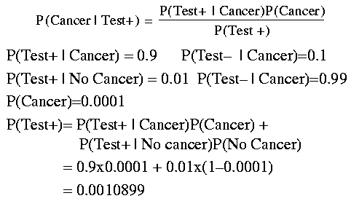
Example: Bayes Rule

Slide 48
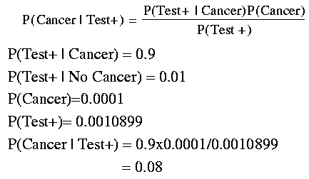
Example: Bayes Rule

Slide 49
Example: Bayes’ rule
Disease Meningitis:
It Cause patient to have stiff neck- 50% of the time.
Prior Probability that Patients has meningitis is 1/50000.
Prior Probability that patient has stiff neck is 1/20.

Slide 50
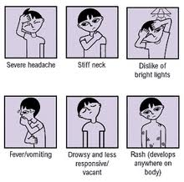

Slide 51
Let s be stiff neck & m be Meningitis.
P(s|m) = 0.5
P(m) = 1/50000
P(s)= 1/20
P(m|s) = P(s|m) P(m)
P(s)
= 0.5 * 1/50000 = 0.0002.
1/20
1 in 5000 patients with stiff neck to have Meningitis.

Slide 52
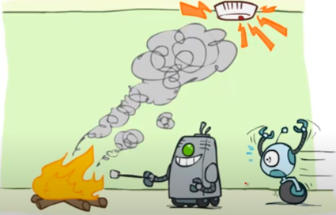
Conditional Independence

Slide 53
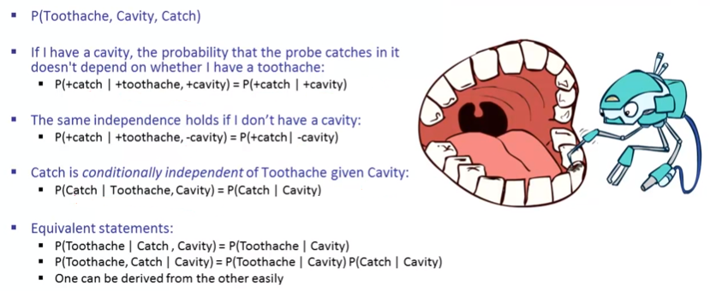
Conditional Independence

Slide 54
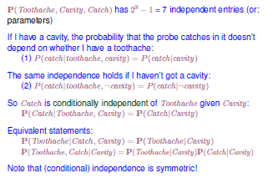
Conditional Independence

Slide 55
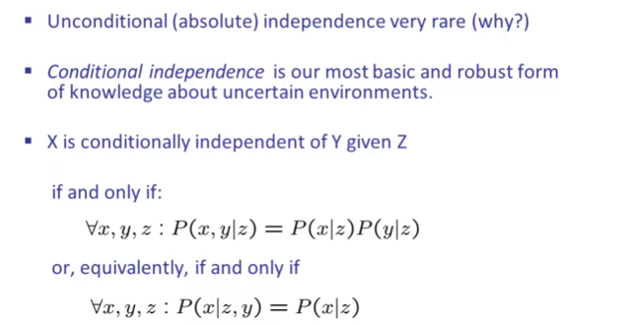
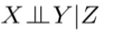
Conditional Independence

Slide 56
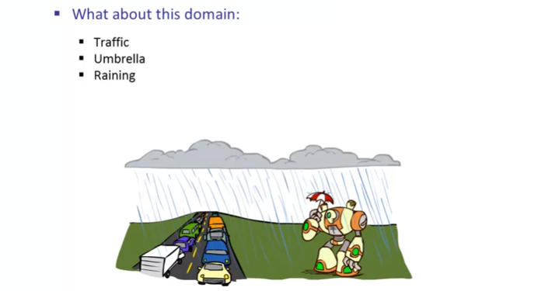
Conditional Independence
Notes:
Traffic independent of umbrella given rains (be aware of assumptions you make)
(The statement is true under certain assumptions…people using umbrella does not lead to increase in traffic. If people in cars slow down or stop to look at the people outside using umbrellas, the traffic will increase)
If u are happy with assumptions, work with it else choose another model

Slide 57
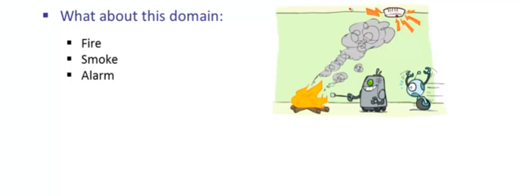
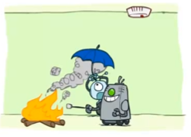
Conditional Independence
Notes:
Fire and alarm are independent given smoke (Fire causes smoke which in turn cause alarm. So we can assume given smoke, fire and alarm are independent)

Slide 58
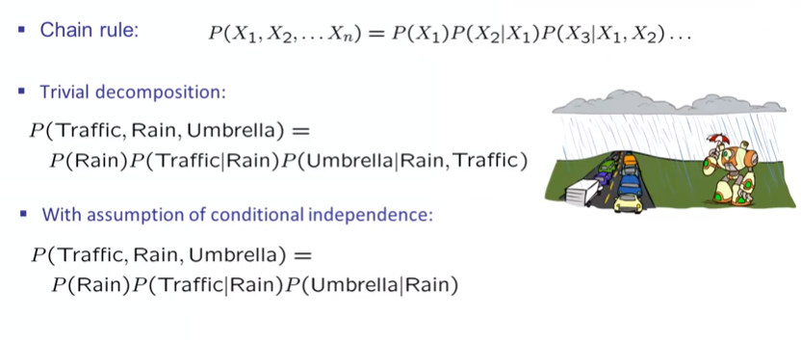
Conditional Independence & Chain Rule
Notes:
Chain rule: seq of vars can be n! Bayes net helps to cut off variables from table leading to compact representations
Condition of one variable given two variables VS Condition of one variable given one variables
Y|x1….xk-> size of full jt distribution 2*2^k (y can be T or F…and k vars 2^k combinations/table entries)

Slide 59
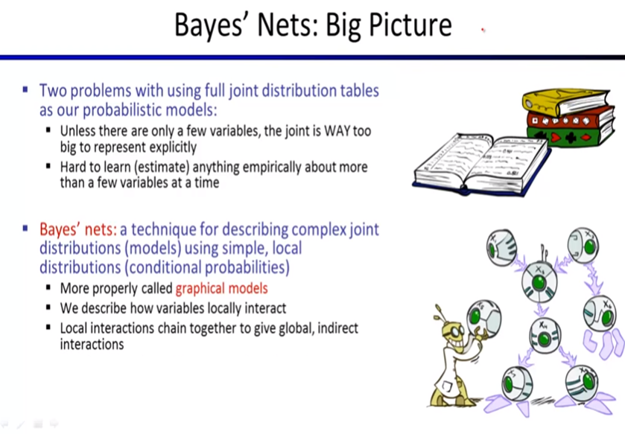

Slide 60
What Bayesian Networks are good for?
Diagnosis: P(cause|symptom)=?
Prediction: P(symptom|cause)=?
cause
cause
Classification: P(class|data)
Decision-making (given a cost function)
symptom
symptom
Medicine
Speech
recognition
Bio-informatics
Text
Classification
Stock market
Computer
troubleshooting

Slide 61
Why learn Bayesian networks?
Combining domain expert knowledge with data
<9.7 0.6 8 14 18>
<0.2 1.3 5 ?? ??>
<1.3 2.8 ?? 0 1 >
<?? 5.6 0 10 ??>
……………….
Efficient representation and inference
Incremental learning
Handling missing data: <1.3 2.8 ?? 0 1 >
Learning causal relationships:
S
C

Slide 62
Probabilistic reasoning- Bayesian network
Bayesian network is a systematic way to represent independence relationships explicitly.
Data structure to represent the dependencies among variables.
Directed graph – each node is annotated with quantitative probability information.

Slide 63
Specification of Bayesian network
A set of random variables makes up the node.
A set of directed links or arrows connects pair of nodes.
X is the Parent of Y.
3. Each node X_{i} has a conditional probability distribution P(X_{i}|Parent(X_{i}))
4. No directed cycles.
X
Y

Slide 64
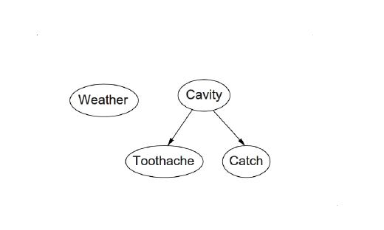
Topology
Nodes & Links – specifies the conditional independence relationships.
Variables Weather ,Toothache ,Catch ,Cavity .

Slide 65
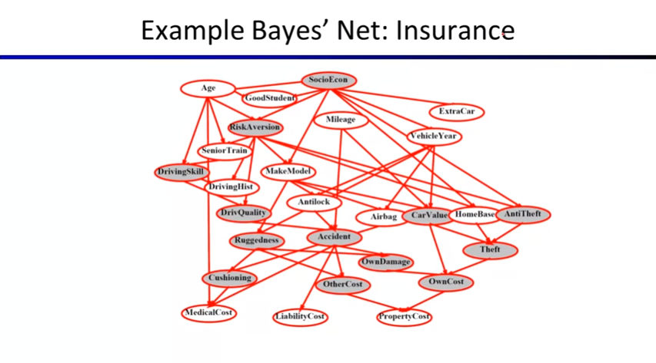

Slide 66
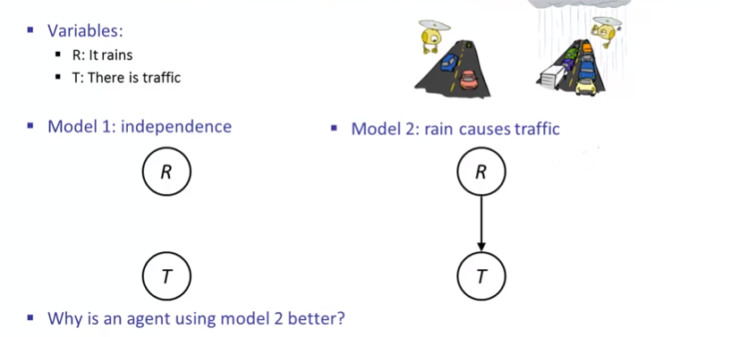
Example: Traffic

Slide 67
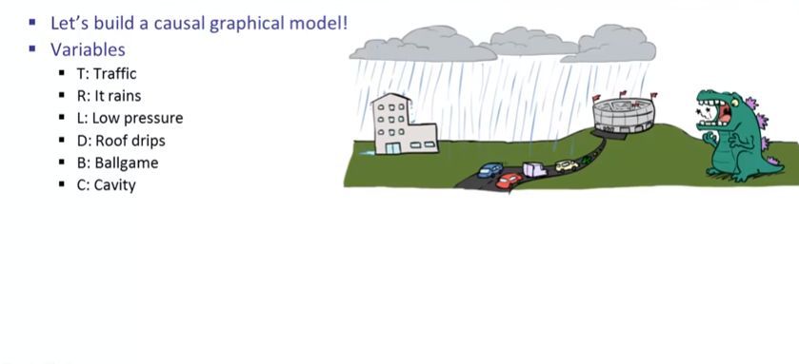
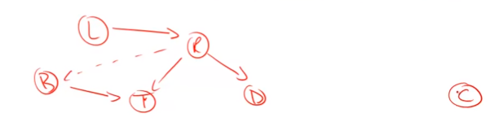
Example: Traffic II

Slide 68
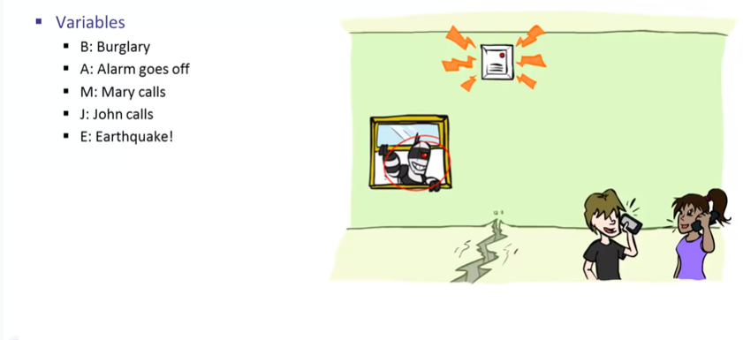
Example: Alarm Network

Slide 69
Semantics of Bayesian network
2 ways to understand:
1. To see the network as a representation of the joint probability distribution.
2. View as an encoding of a collection of conditional independence statements.

Slide 70
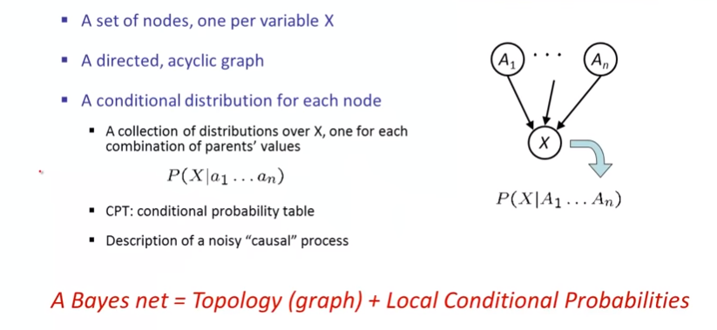
Semantics of Bayesian network

Slide 71
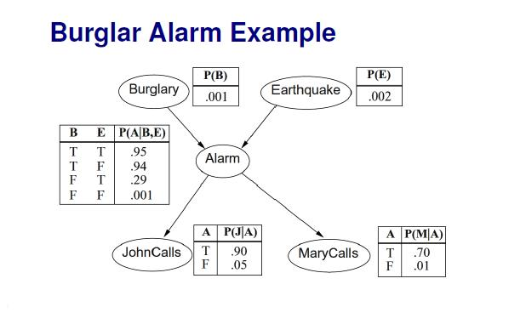



Slide 72
Burglary
Alarm
P(B)
. 001
B | E | P(A)
T | T | .95
T | F | .94
F | T | .29
F | F | .001
Earth Quake
P(E)
.002
John calls
Mary Calls
A | P(J)
T | .90
F | .05
A | P(M)
T | .70
F | .01

Slide 73


Probabilities in Bayes Nets
Joint Distribution for this Bayes Net:
P(cavity, Toothache, Catch) = P(cavity)*P(Toothache | Cavity) * P(Catch | Cavity)

Slide 74

Probabilities in Bayes Nets
Notes:
For chain rule we can have n! ordering of the variables. For Bayes Net we have to choose that ordering which is consistent with the nodes in the graph

Slide 75

Example
Calculate probability that alarm sounds but neither a burglary nor an earth quake has occurred and both John & Mary call.

Slide 76


Node ordering

Slide 77

Node ordering

Slide 78

Example: Flip Coins
P(X1=h) * P(X2=h) * P(X3=t) * P(X4=h)

Slide 79

Example: Burglar Alarm
Notes:
Joint representation -> 2^ 5 enteries

Slide 80

Example: Traffic
P(+r) * P(-t | +r) = ¼* ¼

Slide 81

Example: Traffic

Slide 82

Example: Traffic
Self learn: Causal Vs diagnostic models. Causal better? Why?
Notes:
Same joint distribution. Given joint distribution, there can be multiple representations of Bayes Net. Diff Bayes network, will have diff joint distribution.
Causal models are easier to come up with/think about in practice

Slide 83

Causality

Slide 84

Summary

